Slide 1
American National Insurance Company
We Have Plans for You!
Robert V. Kline, JD, QPA
AVP, Pension Sales

Slide 2
Small Plan Market
Hot Market
New Profit Center For You
Door Opener
Under-Served Market
Ongoing Commissions
Tax Deductions

Slide 3
All Businesses Welcome
Sole Proprietors
C-Corporations
S-Corporations
Professional Service Corporations
LLC’s, LLP’s
Partnerships
All Business Types Welcome

Slide 4
What are the options?
412(e)(3)
Defined Benefit
Cash Balance
Profit Sharing
New Comparability
Safe Harbor
Takeover
SEP
Everything…
401(k) Plan

Slide 5
Business Owner’s Concerns
Reduce Taxes
Favor Business Owner/ Key Employees
Company Profitability
Contribution Flexibility
Low Cost Employee Benefit Plan
For Agent Use Only; Not for distribution or use with consumers.

Slide 6
SECURE ACT
SECURE ACT
Expansion of the tax credit available to small employers who adopt a new qualified plan. The new credit is 50% of the plan’s qualified start up costs with a dollar limit of the greater of a or b:
$500
$250 times the number of non-highly compensated employees eligible to participate in the plan but no more than $5,000.
The credit is available for the plan’s first year and the two years immediately following.
• An additional $500 credit is available for small employer startup plans that include an automatic enrollment provision in the plan.
Example: An Employer sets up a new 401(k) plan covering himself and three employees. The fee to set up the plan is $600 and the annual administration fee is $1,260. The credit is calculated as follows:
($600 + $1,260) X 50% = $930
$250 X 3 = $750
Tax credit = $750

Slide 7
SECURE ACT
SECURE ACT
Extension of the deadline to adopt a plan. Up until now employers operating on a calendar year had to formally adopt a plan by December 31 in order to take tax deductions for contribution made to the plan.
For years beginning after December 31, 2019 the deadline to adopt a stock bonus, profit sharing or pension plan will be the due date of the employer’s tax return including extensions.
Note that the extended deadline does not apply to salary deferrals under a 401(k) plan. For calendar year taxpayers the adoption deadline for 401(k) salary deferrals remains December 31.

Slide 8
Effective Plan Designs
Defined Benefit Plans
Cash Balance Plans
412(e)(3) Plans
New Comparability PS Plans
401(k) Plans
For Agent Use Only; Not for distribution or use with consumers.

Slide 9
Defined Benefit Plans
Large Deductions
Contribution Flexibility
Large benefits for owner
Attractive Employee Benefit
For Agent Use Only; Not for distribution or use with consumers.

Slide 10
Target Contribution Level Illustrated: $290,071
Traditional Defined Benefit Plans
Age |  | Contribution
Owner | 52 | $259,730
Eligible Employee 1 | 32 | $13,256
Eligible Employee 2 | 34 | $12,647
Eligible Employee 3 | 25 | $4,438
$290,071
Owner’s share = 90%

Slide 11
Traditional Defined Benefit Plans
Example Of Contribution Flexibility:
 | Minimum | Maximum | Actual
Year 1 | $171,326 | $290,071 | $290,000
Year 2 | $59,034 | $351,343 | $330,000
Year 3 | $0 | $405,386 | $0

Slide 12
Cash Balance Plans
“Hybrid Plan”
Large Contributions and Deductions
Can provide different levels of benefits for different groups of employees

Slide 13
Cash Balance Plans
Example of Cash Balance Plan With Different Benefit Groups
Employee | Age | Salary | Contribution | Contribution as Percentage of Salary
Owner | 53 | $285,000 | $125,000 | 44%
Manager | 40 | $100,000 | $25,000 | 25%
Employee 1 | 33 | $50,000 | $6,000 | 12%
Employee 2 | 27 | $41,000 | $4,920 | 12%
Total |  | $476,000 | $160,920
First Year Contribution Range: $157,401 - $200,599

Slide 14
412(e)(3) Plans
Guaranteed benefits
Large Death benefits
Fixed Contributions
Large Contributions and Deductions

Slide 15
412(e)(3) Maximum Contributions
Age | Annuity Only | Annuity & Life Insurance
45 | $170,964 | $182,756
50 | $248,363 | $262,899
55 | $305,766 | $323,808
For Agent Use Only; Not for distribution or use with consumers.

Slide 16
Insurance In A 412(e)(3) Plan
No Insurance In The Plan:
Insurance Premium | Annuity Deposit | Total Plan Cost
-0- | 223,692 | $223,692

Slide 17
Insurance In A 412(e)(3) Plan
$2,000,000 Face Amount In The Plan:
Insurance Premium | Annuity Deposit | Total Plan Cost
$83,040 | $150,168 | $233,208
Defined Benefit Plan
Life Insurance

Slide 18
Insurance In A 412(e)(3) Plan
No Insurance = $223,692
With Insurance = $233,208
Plan Cost To Add Insurance = $9,516
After Tax Cost = $6,661
$6,661 After Tax Cost
$ 83,040 Insurance Premium
Notes:
!

Slide 19
Basic Plan
Traditional Profit Sharing or SEP
Age | Salary | Allocation | Percent of Salary
60 | $165,000 | $38,367 | 23%
51 | 38,000 | 8,834 | 23%
42 | 32,000 | 7,441 | 23%
29 | 28,000 | 6,511 | 23%
26 | 26,000 | 6,047 | 23%
 | $289,000 | $67,200 | 23%
Under this plan design, all receive 23%

Slide 20
Enhanced Design
SEP (Traditional PS)
$38,367 | 23%
8,834 | 23%
7,441 | 23%
6,511 | 23%
6,047 | 23%
$67,200
New Comparability
$61,000 | 37%
1,900 | 5%
1,600 | 5%
1,400 | 5%
1,300 | 5%
$67,200
Owner’s Share: 57%
Owner’s Share: 91%

Slide 21
4401(k) Plans
The Case for a 401(k) Plan
$50,000, W-2 Income, Age 50
S Corp. | SEP IRA | 401(k)
Employee Contribution | $ 0 | $ 20,500
Employer Contribution | $ 12,500 | $ 12,500
Catch-up Contribution | $ 0 | $ 6,500
Total: | $12,500 | $39,500
$100,000, W-2 Income, Age 50
S Corp. | SEP IRA | 401(k)
Employee Contribution | $ 0 | $ 20,500
Employer Contribution | $ 25,000 | $ 25,000
Catch-up Contribution | $ 0 | $ 6,500
Total: | $25,000 | $52,000
216%
MORE
108%
MORE

Slide 22
Do You Have To Be An Expert?
NO!
Let American National be your “Back Office” Support

Slide 23
Market the Complete Package
Investment
Advice
Plan Design
Administration
Funding
All in ONE Place
For Agent Use Only; Not for distribution or use with consumers.

Slide 24
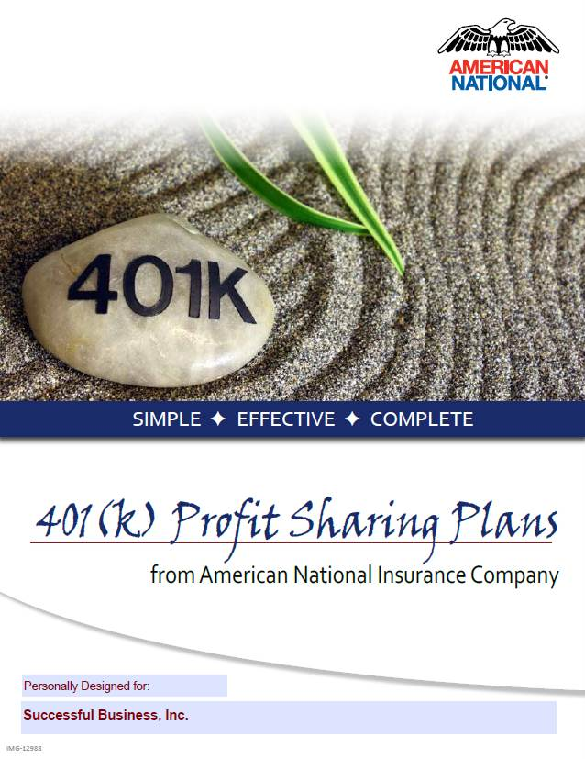
We give you the tools

Slide 25
Our Target Market
Small
Businesses
Ideally 25
Employees
Or Less
Up to 100 Employees in 401(k) Plans

Slide 26
Administrative Fees
Installation
$600
Flat Annual Administration Fee
1-25 Lives Base $400 - $2,600
$20 - $75 per participant

Slide 27
Make It A Habit To “Mention Pension”
To Clients
To Prospects
To All You See And Do Business With
Now is the time to contact your prospects – both new and old.

Slide 28
The Simple Process
You Submit A Census To Us
We Prepare Proposal
We Help You Understand It
You Are Ready To Present To Client

Slide 29
Your Plan Design Team at ANICO
Andy McElhannon,
QKA
Bob Kline,
JD, QPA
Dominic Etienne,
QKA, QPA
Danielle Gothard

Slide 30
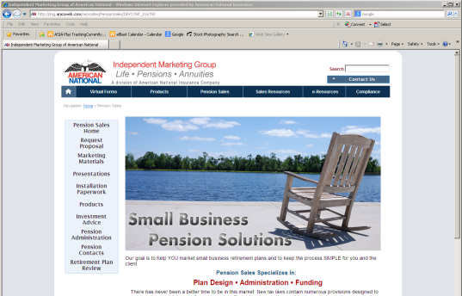
Web Support
http://pension.anicoweb.com
Plan Information
Implementation Docs
Product Information
Marketing Brochures
Proposal Request
Recorded Presentations

Slide 31
American National Insurance Company Pension Sales Department
Contact Information
Contact your marketing representative at Levinson & Associates to get started!
800-375-2279
Marketing@CaryLevinson.com

