Slide 1
ALLIANZ LIFE PRO+®
ADVANTAGE
Fixed Index Universal Life Insurance
Erik Johnson
Regional Sales Consultant
For financial professional use only – not for public distribution.
LPA-6 | 3257591.4
Notes:
We are excited to present Allianz Life Pro+ Advantage fixed index universal life insurance policy. In this presentation, you’ll learn more about Allianz life sales growth, and our product and additional tools available.

Slide 2
Industry evolution
YTD 2021 Rank | Carrier | % Change from 2020
1 | Pacific Life | -9%
2 | National Life Group | 45%
3 | Allianz Life | 46%
4 | Nationwide | 53%
5 | John Hancock | 23%
Source: LIMRA 2Q21YTD U S Retail Individual Life Insurance Sales BY CHANNEL with All Splits

Slide 4
Life Growth Strategy
200
175
160
150
121
101
Actual Sales
Projected Sales
(millions)
(millions)

Slide 5
What’s driving our growth?
Volatility controlled indexes
Index lock and index lock report
Commitment to inforce
Loan flexibility
Delivering customer value
Notes:
Read slide.

Slide 6
Allianz Life Pro+ Advantage
Expanded. Enhanced. Exclusive.
Exclusive features
Expanded bonus opportunities
Enhanced sales tools
Notes:
Innovations keep us standing out in the market:
• Expanded bonus opportunities – including our Classic (flat-rate) bonus for a guaranteed credit, along with a streamlined indexing story (Pick your bonus / Pick your crediting method).
• Exclusive features – including our own volatility control indexes and Index Lock to help provide more consistent performance in today’s environment.
• Enhanced sales tools to more easily tell our story – including a simplified consumer brochure, consumer video, showcase tool for customizable case studies, and redesigned illustrations.

Slide 7
Allianz Life Pro+® Advantage
Fixed Index Universal Life Insurance Policy
7702 changes
What you need to know
from Allianz
The interest rates used to calculate the Guideline and MEC premiums were lowered.
Allows for increased funding limits for the policyholder.
Allianz took the time to review our product and find a balance that meets the needs for both consumers and financial professionals, adhering to the new guidelines.
Notes:
As part of the stimulus package signed into law on December 27, 2020, there were changes to the Internal Revenue Code (IRC) that impact the minimum interest rate assumptions used for determining if a product qualifies as life insurance under IRC section 7702; or IRC section 7702A for Modified Endowment Contract (MEC) calculations. The interest rates used to calculate the Guideline and MEC premiums were lowered, which now allows for increased funding limits for the policyholder.
For the consumer: In many scenarios, potential loan values have become more competitive, this comes as a tradeoff to reduced death benefit.
For the financial professional: Target Premium has been recalibrated to align with expected lower death benefits.
For Allianz: Rebalanced charges for 7702 changes and lower death benefits to meet our standards while still offering a competitive product

Slide 8
Allianz Life Pro+® Advantage
Death benefit protection
Living advantages
Accumulation potential
Access to any available cash value¹
Access to death benefit in case of chronic² or terminal illness³
Tax advantages
¹Policy loans and withdrawals will reduce the available cash value and death benefit and may cause the policy to lapse, or affect guarantees against lapse. Withdrawals in excess of premiums paid will be subject to ordinary income tax. Additional premium payments may be required to keep the policy in force. In the event of a lapse, outstanding policy loans in excess of unrecovered cost basis will be subject to ordinary income tax. If a policy is a Modified Endowment Contract (MEC), policy loans and withdrawals will be taxable as ordinary income to the extent there are earnings in the policy. If any of these features are exercised prior to age 59½ on a MEC, a 10% federal additional tax may be imposed. Tax laws are subject to change and you should consult a tax professional.
²Additional cost applies when exercised. There is no cost if you do not exercise the rider. Charges are based on age, gender, premium class, current cash value, and current discount factor interest rate at the time of acceleration. Rider is not available in all states. Refer to appropriate consumer brochure for state specific information.
³Must be certified terminally ill with a life expectancy of 12 months or less to access a portion up to 100% of the policy’s death benefit while the insured is still living. May be taxable. Refer to appropriate consumer brochure for state specific information.
Notes:
Allianz Life Pro+ Advantage provides death benefit protection. The generally income-tax-free death benefit can help beneficiaries cover various financial concerns.
In addition to death benefit protection, Allianz Life Pro+ Advantage also provides many living advantages as well, such as:
Accumulation potential
Access to any available cash value through policy loans and withdrawals
Access to death benefit in case of chronic or terminal illness
Tax advantages such as a generally Income-tax-free death benefit, Tax-deferred cash value accumulation and Income-tax-free loans and withdrawals

Slide 9
Exclusive features

Slide 10
Volatility Controlled Indexes
BLOOMBERG US DYNAMIC BALANCE II ER INDEX
Manages volatility dynamically
Designed to give the opportunity for a level of stability in renewal rates.
PIMCO TACTICAL BALANCED ER INDEX
Manages volatility with a level of protection against rising interest rates

Slide 11
Index lock feature
Track and view index values online
Lock in index values on select indexed interest allocations anytime once during crediting period
Available on volatility controlled indexes:
Bloomberg US Dynamic Balance II ER Index
PIMCO Tactical Balanced ER Index
Help minimize the effects of mid-term market volatility
The index lock occurs at the end of the business day, therefore the actual value received may be more or less than the value at the time of request. See CSI-512 for full details and business rules.
Notes:
The index lock feature gives clients and their financial professionals the flexibility to track and view index values online and initiate index value locks on certain index allocation options anytime once during the crediting period. This helps minimize the effects of midyear market volatility while also assuring clients a positive index credit.
Lets take a closer look at how this works.

Slide 12
TWO ways to LOCK IN A GAIN on an FIUL policy
Manual Lock
Choose when to lock the index interest rate % during a crediting period
Auto Lock
Set an upper target to activate an index lock automatically
Auto Lock is available on all policies with Index Lock capability
Allianz Life Pro+® Advantage Fixed Index Universal Life Insurance Policy
Allianz Life Pro+® Fixed Index Universal Life Insurance (all waves)
Index allocations:
Annual Point to Point with Participation Rate
Bloomberg US Dynamic Balanced II ER Index
PIMCO US Tactical Balance ER Index
For Index Lock details and/or business rules, see CSI-512 or allianzlife.com/indexlock
Available to lock each allocation option once per crediting period
Notes:
There are 2 ways to lock in interest on a Fixed Index Universal Life Insurance Policy. The first way, a manual index lock, lets you choose when to lock in the index interest rate percentage by accessing the Allianz secure site and selecting manual index lock.
The second way, an auto lock, gives you the option to set an upper target on the Index Lock feature. When the target is reached, it will lock in the desired indexed interest rate percentage automatically. Both options can assure your clients a positive interest credit (once locked in) no matter what happens for the remainder of the clients crediting period. The main focus of this presentation will be Auto Lock. For more information please check out the Index lock presentation or allianzlife.com/indexlock.

Slide 13
Hypothetical example
Policy year 1
Year 1: Locked in at month 9 at an index level of 108. Without index lock, client would’ve received an index level of 102.
Index lock 108
110
100
Year 1 end
102
Year 2 starts at 102, not from where it was locked.
90
80
Policy
issue
Year 1 end
Index anniversary
This hypothetical example is provided for illustrative purpose only and is intended to show how the index lock feature could work. It is not intended to predict or guarantee future results.
Notes:
In this hypothetical example, in policy year 1 the index starts at 100 and ends at 102. However, three quarters into the year through the year the decision was made to lock in the index value at 108. (click) In year 1, because the index value was locked in at 108, the policy would be credited a higher rate compared to where the index value actually ended on the policy anniversary/at the end of the crediting period.
(click) The 102 ending point will be the starting index value for policy year 2.

Slide 14
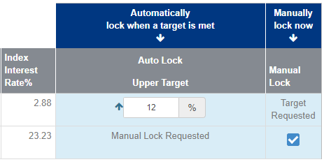
How to activate an Index Lock
Sample website view
Index allocations, crediting period start and end date not shown. Website view subject to change.
Option 1: Auto Lock
Set upper target online
If the allocation option’s index interest rate % reaches the target, Auto Lock will automatically lock in the index value until the end of the crediting period¹
6.7
10.8
Option 2: Manual Lock
¹ Setting targets authorizes Allianz to automatically activate an Index Lock once the target is reached based on the index interest rate percentage at the end of the business day. Because of this, your index interest rate percentage may be higher than your target. This service may be discontinued at any time.
Choose when to lock
If a lock has not already taken place simply request a manual index lock at any point during the crediting period²
² You may activate an Index Lock manually online at any time, as long as an Auto Lock hasn’t already been activated. Activating Index Lock manually will cancel any current targets you have set for the current crediting period. If you decide to activate Index Lock manually – or if neither target has been reached at the end of your current crediting period – you will need to set new targets for the next crediting period.
Index lock is available with select index allocations. For more information and business rules check out CSI-512 and/or allianzlife.com/indexlock
Notes:
There are two ways to activate an index lock:
The first way is automatically with our Auto Lock feature. Simply set the index interest rate percentage you wish to target. You can set an upper target, as long as you set it above the current index interest rate percentage. If the allocation option’s index interest rate percentage reaches the target, Auto Lock will automatically lock in the index value until the end of the crediting period.¹
You are also free to adjust the target index interest rate percentage – either up or down – as many times as you wish, as long as Auto Lock hasn’t been activated during that crediting period and your upper target is greater than the current index interest rate percentage. And it’s easy to administer: Just log in to your clients policies online to set or reset Auto Lock.²
The 2nd way to activate index lock is a manual index lock. If a lock has not already taken place, simply request a manual lock anytime within the crediting period. Both options make it easier for your clients to receive a positive index credit in volatile markets and both options can easily be done within our secure website. Index lock is available on select index allocations. For more information, check out CSI-512 and/or allianzlife.com/indexlock.

Slide 15
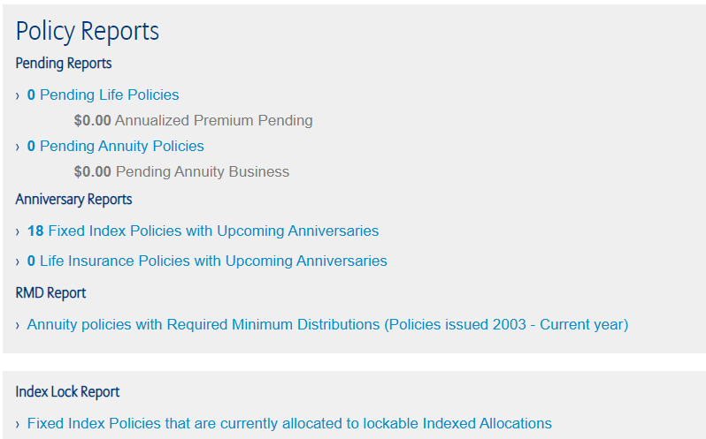
Greater insight with on-demand Index Lock Report
Notes:
The Allianz Index Lock Report, available on the Allianz website, is our easy-to-use and flexible tool for you to gain greater insight into your clients’ products.

Slide 16
Bonus opportunities
Notes:
There are several marketing solutions to highlight as part of this product launch.

Slide 17
A simplified index story: Choose an index. Choose a bonus opportunity or crediting method.
2
CHOOSE A BONUS
1
CHOOSE AN INDEX
2
CHOOSE A CREDITING METHOD
Notes:
There are two steps to helping your client’s identify which allocation option could be a good fit for them. Step one, choose an index. Step two, choose a bonus opportunity or choose a crediting method.

Slide 18
Step 1: Choose an index
Bloomberg US Dynamic Balance II ER Index
Comprised of the Bloomberg US Equity Custom Futures ER Index and the Bloomberg Barclays US Aggregate Custom RBI Unfunded Index.
APP with a cap
APP with a participation rate
PIMCO Tactical Balanced ER Index
Comprised of the U.S. Equity Futures Custom Index and a bond component comprised of the PIMCO Synthetic Bond ER Index
Blended Index
A blend of four indexes, including: 35% Dow Jones Industrial Average, 35% Bloomberg Barclays U.S. Aggregate Bond Index, 20% EURO STOXX 50®, and 10% Russell 2000® Index
The indexes available within the policy are constructed to keep track of diverse segments of the U.S. or international markets, or specific market sectors. These indexes are benchmarks only. Indexes can have different constituents and weighting methodologies. Some indexes have multiple versions that can weight components or may track the impact of dividends differently. Although an index may affect your interest credited, you cannot buy, directly participate in or receive dividend payments from any of them through the policy.
Notes:
In one path of step one, there are the following indexes to choose from:
[click] The Bloomberg US Dynamic Balance II ER Index is comprised of the Bloomberg US Equity Custom Futures ER Index and the Bloomberg Barclays US Aggregate Custom RBI Unfunded Index and shifts weighting between them daily based on historical realized volatility.
[click] The PIMCO Tactical Balanced ER Index is comprised of the U.S. Equity Futures Custom Index and a bond component comprised of the PIMCO Synthetic Bond ER Index with a duration overlay and shifts weighting between them daily based on historical realized volatility of the components.
[click] The Blended Index is A blend of four indexes, including: 35% Dow Jones Industrial Average, 35% Bloomberg Barclays U.S. Aggregate Bond Index, 20% EURO STOXX 50® Index, and 10% Russell 2000® Index.
The client could also choose the S&P 500® Index or the Fixed Interest allocation. We’ll talk more about that in a moment.

Slide 19
Step 2: Choose a bonus opportunity
Available indexes
Standard
Classic
Bonused
Select
Bloomberg US Dynamic Balance ER Index
No bonus
0.90% guaranteed flat rate bonus¹
15%
multiplier bonus opportunity
40%
multiplier bonus opportunity
PIMCO Tactical Balanced ER Index
Blended Index
Annual point-to-point with a cap or participation rate crediting method
No asset charge
1% annual asset charge
¹ Includes an allocation restriction, meaning clients may not be able to allocate 100% of their accumulation value, if the fixed account goes below 1%.
Notes:
Next is step two - choosing a bonus. With the Bloomberg US Dynamic Balance II ER Index, PIMCO Tactical Balanced ER Index and Blended Index, there are several bonus opportunities to choose from. There bonus opportunities all begin in policy year one.
Standard: No bonus
For clients who are willing to forego the potential for a bonus in favor of higher caps and participation rates, which may result in a higher indexed interest received.
Classic: 0.90% guaranteed flat rate bonus
A bonus design that adds a consistent bonus rate to the policy’s annual accumulation value. The bonus rate is established at issue and is guaranteed for the policy year. This could be for clients who may want a conservative approach and a guaranteed credit.
Bonused: 15% multiplier bonus
This design multiplies any annual indexed interest by 15%. This could be for a client who is looking for a moderate choice with bonus potential but no charges associated with the bonus.
Select: 40% multiplier bonus with a 1% annual asset charge
A bonus design that multiplies any annual indexed interest by 40% but also includes a 1% annual asset charge. This could be for clients who are willing to pay a charge in return for a higher bonus and greater indexed interest potential.

Slide 20
Step 2: Choose a crediting method
2
CHOOSE A CREDITING METHOD
APP WITH A CAP
MONTHLY SUM
TRIGGER METHOD
S&P 500® Index
Note: The fixed interest allocation provides the client an interest credit of at least the minimum interest rate provided for by the policy, backed by Allianz’s general account
Notes:
In the second path from step one, there are the following indexes to choose from:
If they select the S&P® 500 index, their second step will be to choose a crediting method. The options available are annual point to point with a cap, monthly sum and trigger method. This index does not offer a bonus.
Also, keep in mind that clients can also allocate to the fixed interest allocation which provides the client an interest credit of at least the minimum interest rate provided for by the policy, backed by Allianz’s general account.
Now let’s take a closer look at how to help your clients pick an index allocation option.

Slide 21
Available index allocation options
 | Bloomberg US Dynamic II ER Index | PIMCO Tactical Balanced ER Index | Blended index | S&P 500® index
 | Annual point-to-point with a participation rate | Annual point-to-point with a participation rate | Annual point-to-point with a cap | Annual point-to-point with a cap | Monthly sum with a cap | Trigger
Standard: no bonus
Classic: 0.90% flat rate bonus¹ |  |  |  | N/A
Bonused: 15% bonus opportunity
Select: 40% bonus opportunity 1% annual asset charge
X
X
X
X
X
X
X
X
X
X
X
X
X
X
X
¹ Includes an allocation restriction, meaning clients may not be able to allocate 100% of their accumulation value, if the fixed account goes below 1%.
Notes:
To summarize, these are the available index allocation options.

Slide 22
Bloomberg US Dynamic Balance II ER Index 2019 Peaks and Valleys
Life Pro+ Advantage
Potential Credit
Dates | Peaks/Valleys | Bonused [155%] Participation Rate with 15% Bonus | Select [150%] Participation Rate with 40% Bonus
4/30/2019 | 6.26% | 11.76% | 13.86%
5/13/2019 | 3.76% | 6.58% | 7.75%
6/20/2019 | 7.69% | 13.81% | 16.27%
6/26/2019 | 6.88% | 14.90% | 17.56%
7/3/2019 | 8.39% | 9.45% | 11.13%
8/5/2019 | 6.03% | 13.72% | 16.17%
9/6/2019 | 8.85% | 9.09% | 10.71%
10/2/2019 | 7.38% | 11.16% | 13.15%
11/27/2019 | 10.99%
12/3/2019 | 9.91% | 17.66%
12/27/2019 | 13.02% | 23.21%
Bonused 145% Participation Rate with 15% Bonus | Select 140% Participation Rate with 40% Bonus
10.43% | 12.27%
6.26% | 7.36%
12.82% | 15.07%
11.47% | 13.48%
13.99% | 16.44%
10.05% | 11.81%
14.75% | 17.34%
12.30% | 14.46%
18.32% | 21.54%
16.52% | 19.42%
21.71% | 25.51%
Source: https://www.bloomberg.com/quote/BTSIDB2E:IND
This is a hypothetical example and does not deduct for any policy fees or charges which would reduce values shown. In an effort to help the index achieve the target volatility, the index was changed as of 4/21/2020; therefore, any historical depictions including hypothetical returns will not include this change for data prior to 4/21/2020.
Notes:
First, take a look at the last year performance of the Bloomberg US Dynamic Balance II ER Index Allocation option. What you see here are the peaks and valleys throughout 2019. As you can see even though this is a volatility controlled allocation option, there was still movement throughout the year. Currently we illustrate the Life Pro+ Advantage Fixed Index Universal Life insurance policy at a max illustrated rate of 6.9%. Had a policy with index lock been issued on January 2nd there would have been six periods of time that the policy could have been locked in above the max illustrated rate.
(CLICK)
This next section of information shows the outcome of each of the hypothetical locks for the Bonused allocation option with a 155% participation rate and 15% bonus as well as the Select allocation option with 150% participation and 40% bonus. As you can see, the credits for the Select allocation would come out higher based on the current participation rate and bonus.
Keep in mind that there is a 1% asset fee for this option that will change the final outcome of the index lock. We will look more closely at the index credit needed to overcome the asset charge and at what point the Select allocation options could overcome the asset fee and outperform the Bonused option.

Slide 23
Enhanced sales tools
Notes:
There are several marketing solutions to highlight as part of this product launch.

Slide 24
Updated consumer brochures
Notes:
An additional part of this launch includes updated consumer brochures.

Slide 25
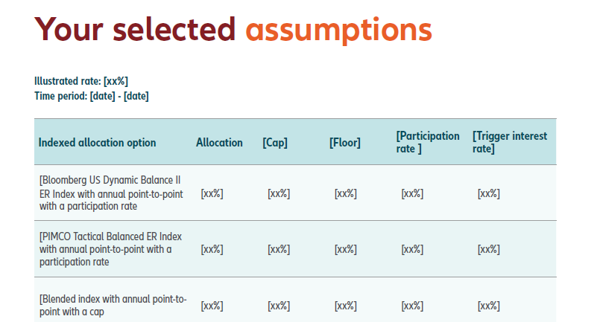
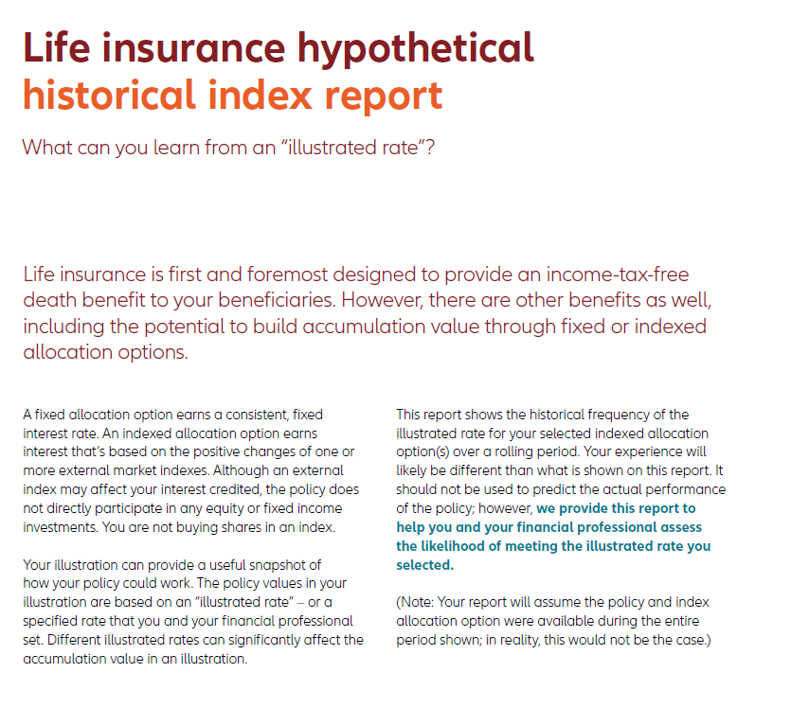
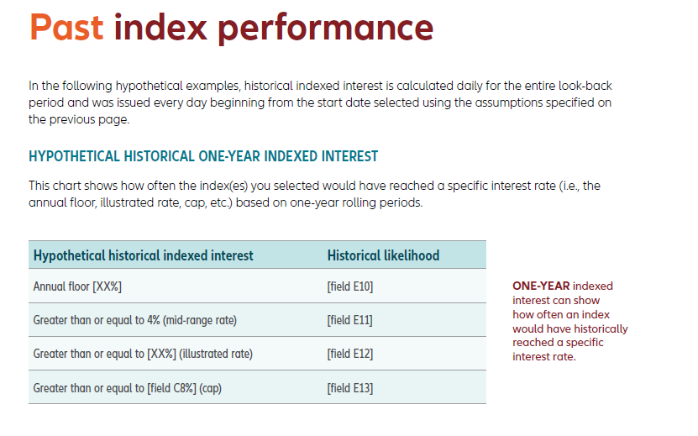
Backcasting Tool
Key feature highlight 1
Key feature highlight 2
Key feature highlight 3
Notes:
The first digital tool is our backcasting tool which has been updated and improved for use. The first digital tool is our backcasting tool which has been updated and improved for use. Backcasting provides insight into historical frequency of the illustrated rate for your selected indexed allocation option over a rolling period.

Slide 26
Allianz Showcase
Demonstrate the power of different crediting methods in a case study format
Notes:
Allianz Showcase is a supplemental tool to help you educate customers on the working mechanics of our products.

Slide 27
AllianzShowcase.com
www.AllianzShowcase.com
Allianz Showcase:
In addition to the death benefit, purchasing fixed index universal life (FIUL) insurance can be a tax efficient way for your clients the opportunity to build accumulation value to help supplement their retirement income through the use of policy loans or withdrawals¹. There are many factors that impact how much retirement income may be available at the time they retire. One of those factors are bonuses. Allianz Life Pro+ Advantage℠ Fixed Index Universal Life Insurance Policy offers multiple bonus options (along with an option without a bonus).
Showcase will help provide education on how policy values could be impacted by bonuses based on selections below.
Age
35, 45, 55, or 65
$10K, $25K, or $50K annually
Premium Amount
Premium Funding Schedule
5, 10 or 20 Pay
Submit
¹Policy loans and withdrawals will reduce the available cash value and death benefit and may cause the policy to lapse, or affect guarantees against lapse. Withdrawals in excess of premiums paid will be subject to ordinary income tax. Additional premium payments may be required to keep the policy in force. In the event of a lapse, outstanding policy loans in excess of unrecovered cost basis will be subject to ordinary income tax. If a policy is a modified endowment contract (MEC), policy loans and withdrawals will be taxable as ordinary income to the extent there are earnings in the policy. If any of these features are exercised prior to age 59½ on a MEC, a 10% federal additional tax may be imposed. Tax laws are subject to change and you should consult a tax professional.
Bonused products may include higher surrender charges, longer surrender periods, lower caps, or other restrictions that are not included in similar products that don’t offer a bonus. The index allocations that offer the interest bonus will generally have lower caps and participation rates. Not all bonuses guarantee that a policy will be credited with an interest bonus every year as some are based on the growth of an index.
For financial professional use only – not for use with the public.

Slide 28
5 Steps to Selling Fixed Index Universal Life Insurance
01
02
03
04
05
Prospecting and identifying the ideal client
Fact-finding, goal setting and identifying risk tolerance
Designing the FIUL policy
Validating the chosen illustrated rate
Educating how different crediting methods could work
Marketing materials
Product training
Illustration training
Product illustrations
Backcasting
Allianz Showcase
Notes:
CTA call

Slide 29
Loan Flexibility & Riders

Slide 30
Policy Loans
Competitive and flexible options for accessing available cash value accumulation
Fixed interest loans
Indexed loans
Borrow from a policy’s available cash value accumulation at a fixed interest rate
Locked 5% annual loan charge guaranteed at issue
Cash value can still receive indexed interest when an indexed loan is taken
Policy Years 1-10
Policy Years 11+
Interest is payable in advance and deducted from the cash value
low net cost
of up to 1%
low net cost
of 0%
Loan amount continues to earn potential indexed interest
Interest charge can be offset by the potential credited index interest (no guarantee)
Policy loans and withdrawals will reduce the available cash value and death benefit and may cause the policy to lapse, or affect guarantees against lapse. Withdrawals in excess of premiums paid will be subject to ordinary income tax. Additional premium payments may be required to keep the policy in force. In the event of a lapse, outstanding policy loans in excess of unrecovered cost basis will be subject to ordinary income tax. If a policy is a modified endowment contract (MEC), policy loans and withdrawals will be taxable as ordinary income to the extent there are earnings in the policy. If any of these features are exercised prior to age 59½ on a MEC, a 10% federal additional tax may be imposed. Tax laws are subject to change and you should consult a tax professional.
Notes:
[Click]
During the first 10 policy years, your clients may take a fixed interest loan from their Allianz IUL policy for a low net cost of up to 1%.
After the first 10 policy years, your clients may take a fixed interest loan from their Allianz IUL policy for a net cost of 0%.
A fixed interest loan is available on all Allianz IUL policies.
There are a few things to note about indexed loans.
[Click] While many carriers may offer competitive indexed loan amounts that are locked in, Allianz offers a locked 5% annual loan charge that won’t change for the life of the Allianz IUL policy.
[Click] The policy’s cash value can still receive indexed interest when an indexed loan is taken.
[Click] At the time the loan is taken, interest is payable in advance and is deducted from the cash value.
[Click] Another competitive offering by Allianz is that the loan amount also continues to earn potential indexed interest that is credited annually.
[Click] The interest charge of the loan can be offset by the potential credited indexed interest, but there is no guarantee the policy will earn enough interest to offset the cost of the loan.
Keep in mind that an indexed loan contains more risk than a fixed interest loan any it may not be suitable for all clients.

Slide 31
Access to income-tax-free loans
Offering fixed and indexed loans
Flexibility to switch between loan types each policy anniversary
The ability to blend loan types (e.g., 50% indexed loans and 50% fixed loans)
Opportunities for diversification with different allocations for loaned and unloaned values
Interest bonus is applied to loaned and unloaned values
Guaranteed 5% annual indexed loan rate²
¹Policy loans and withdrawals will reduce the available cash value and death benefit and may cause the policy to lapse, or affect guarantees against lapse. Withdrawals in excess of premiums paid will be subject to ordinary income tax. Additional premium payments may be required to keep the policy in force. In the event of a lapse, outstanding policy loans in excess of unrecovered cost basis will be subject to ordinary income tax. If a policy is a modified endowment contract (MEC), policy loans and withdrawals will be taxable as ordinary income to the extent there are earnings in the policy. If any of these features are exercised prior to age 59½ on a MEC, a 10% federal additional tax may be imposed. Tax laws are subject to change and you should consult a tax professional. ² The loan rate is locked in at issue and guaranteed for the life of the policy.
Notes:
Allianz Life Pro+ Advantage offers competitive and flexible options for accessing available cash value accumulation through fixed and indexed loans. We offer:
- Flexibility to switch between loan types each policy anniversary
- The ability to blend loan types (e.g., 50% indexed loans and 50% fixed loans)
- Opportunities for diversification with different allocations for loaned and unloaned values
- Interest bonus is applied to loaned and unloaned values and
- A Guaranteed 5% annual indexed loan rate²
Keep in mind that an indexed loan contains more risk than a fixed interest loan and it may not be suitable for all clients.

Slide 32
Living advantages and product riders Accelerate and access a portion of the death benefit
Chronic Illness Accelerated Death Benefit Rider^{1,2,3}
Premium Deposit Fund Rider
Riders
and benefits¹
Accelerates the death benefit if the insured becomes chronically ill or cognitively impaired (under specific criteria)
Combines all the advantages of life insurance with the simplicity of a single lump-sum payment. ^{4,5}
Terminal Illness Rider
Child Term Rider
Enhanced Liquidity Rider
Loan Protection Rider
Supplemental Term Rider
Waiver of New Charges Benefit
Waiver of Specified Premium Rider
¹ This rider may not be available in all states and the name may vary by state.
² The Chronic Illness Accelerated Death Benefit Rider is included with the policy, subject to age and underwriting requirements. There is a fee charged as a discount factor against every accelerated payment if the rider is exercised. The discount factor is based on age, premium class, current cash value of the policy, and current discount factor interest rate at that time. The maximum discount factor is determined by the life expectancy of the insured and the discount factor at the time of acceleration. Name may vary by state.
³ This rider is not available if the insured is under age 18.
⁴Additional premium payments may be required if the policy features, including monthly cost of insurance, expenses and the Premium Discount Rate, change the issue.
⁵Allianz will not allow a policy utilizing PDF Rider to be issued as a MEC. If the policy becomes a MEC for any reason when there is an active PDF account, the PDF account will terminate and any remaining balance will be returned to the owner.
Notes:
Another highlight of Allianz Life Pro+ Advantage are the living advantages and product riders. Keep in mind some may come at an additional cost and some are automatically included in the policy.
Chronic Illness Accelerated Death Benefit Rider: Accelerates the death benefit if the insured becomes chronically ill or cognitively impaired (under specific criteria)
Premium Deposit Rider: After a lump sum is deposited into the PDF, premiums are automatically transferred from the PDF into the life insurance policy, giving clients a disciplined premium payment approach.
Some additional riders and benefits include:
Terminal Illness Rider
Child Term Rider
Enhanced Liquidity Rider
Loan Protection Rider
Supplemental Term Rider
Waiver of New Charges Benefit
Waiver of Specified Premium Rider

Slide 33
Accelerated Underwriting Program
Criteria
Triage
Final Underwriting Offer
Product Availability: Allianz Life Pro+ Advantage using worksheet process
Issue Ages: 25 - 60
Death Benefit Amount: $3,000,000 or less (includes existing coverage with Allianz)
Risk Classes: Preferred Nontobacco and Preferred Plus Nontobacco
MVR, MIB, Underwriting Consumer Report and Prescription Database Check
Based on the triage results, the policy continue with Accelerated Underwriting or move to Full Underwriting
Phone History interview is completed and imported into tool
Accelerated Underwriting offer is provided
Underwriter reviews policy financially and any underwritten riders
Final Underwriting offer is extended
Notes:
Please note: best risk classes still available through full underwriting.

Slide 34
THANK YOU.
www.allianzlife.com/lifesalestools
Sales, marketing and business tools
Guarantees are backed by the financial strength and claims-paying ability of Allianz Life Insurance Company of North America. Products are issued by Allianz Life Insurance Company of North America.
Product and feature availability may vary by state and broker/dealer.
P64339
Notes:
Thank you for attending today’s training! For more information about the product or features, go to www.allianzlife./lifesalestools. For additional questions or support, please contact our Life Case Design team at 800.950.7372.

Slide 35
Disclosure
Guarantees are backed by the financial strength and claims-paying ability of Allianz Life Insurance Company of North America. Products are issued by Allianz Life Insurance Company of North America.
Product and feature availability may vary by state and broker/dealer.
P64339
Policy loans and withdrawals will reduce the available cash value and death benefit and may cause the policy to lapse, or affect guarantees against lapse. Withdrawals in excess of premiums paid will be subject to ordinary income tax. Additional premium payments may be required to keep the policy in force. In the event of a lapse, outstanding policy loans in excess of unrecovered cost basis will be subject to ordinary income tax. If a policy is a modified endowment contract (MEC), policy loans and withdrawals will be taxable as ordinary income to the extent there are earnings in the policy. If any of these features are exercised prior to age 59½ on a MEC, a 10% federal additional tax may be imposed. Tax laws are subject to change and you should consult a tax professional.
The indexes available within the policy are constructed to keep track of diverse segments of the U.S. or international markets, or specific market sectors. These indexes are benchmarks only. Indexes can have different constituents and weighting methodologies. Some indexes have multiple versions that can weight components or may track the impact of dividends differently. Although an index may affect your interest credited, you cannot buy, directly participate in, or receive dividend payments from any of them through the policy.
No single index allocation option will be most effective in all market environments. Index allocation options may be subject to a cap and/or participation rate.
The S&P 500® Index is comprised of 500 stocks representing major U.S. industrial sectors. The Dow Jones Industrial Average is a popular indicator of the stock market based on the average closing prices of 30 active U.S. stocks representative of the overall economy.
S&P® is a registered trademark of Standard & Poor’s Financial Services LLC(“S&P”) and Dow Jones® is a registered trademark of Dow Jones Trademark Holdings LLC (“Dow Jones”). These trademarks have been licensed for use by S&P Dow Jones Indices LLC and its affiliates. S&P® and S&P 500® are trademarks of S&P and Dow Jones®, Dow Jones Industrial Average℠, DJIA and The Dow are trademarks of Dow Jones. These trademarks have been sublicensed for certain purposes by Allianz Life Insurance Company of North America (“Allianz”). The S&P 500 and Dow Jones Industrial Average (DJIA) are products of S&P Dow Jones Indices LLC and/or its affiliates and have been licensed for use by Allianz. Allianz products are not sponsored, endorsed, sold, or promoted by S&P Dow Jones Indices LLC, Dow Jones, S&P, or their respective affiliates and neither S&P Dow Jones Indices LLC, Dow Jones, S&P, or their respective affiliates make any representation regarding the advisability of investing in such product.
The Russell 2000® Index is an equity index that measures the performance of the 2,000 smallest companies in the Russell 3000® Index, which is made up of 3,000 of the biggest U.S. stocks. The Russell 2000® Index is constructed to provide a comprehensive and unbiased small-cap barometer and is completely reconstituted annually to ensure larger stocks do not affect the performance and characteristics of the true small-cap index.
Notes:
Guarantees are backed by the financial strength and claims-paying ability of Allianz Life Insurance Company of North America. Products are issued by Allianz Life Insurance Company of North America.
Product and feature availability may vary by state and broker/dealer.
P64339

Slide 36
Disclosure
The Russell 2000® Index (the “Index”) is a trademark of Frank Russell Company (“Russell”) and has been licensed for use by Allianz Life Insurance Company of North America (“Allianz”). Allianz products are not in any way sponsored, endorsed, sold or promoted by Russell or the London Stock Exchange Group companies (“LSEG”) (together the “Licensor Parties”) and none of the Licensor Parties make any claim, prediction, warranty or representation whatsoever, expressly or impliedly, either as to (i) the results to be obtained from the use of the Index (upon which the Allianz product is based), (ii) the figure at which the Index is said to stand at any particular time on any particular day or otherwise, or (iii) the suitability of the Index for the purpose to which it is being put in connection with the Allianz product. None of the Licensor Parties have provided or will provide any financial or investment advice or recommendation in relation to the Index to Allianz or to its clients. The Index is calculated by Russell or its agent. None of the Licensor Parties shall be (a) liable (whether in negligence or otherwise) to any person for any error in the Index or (b) under any obligation to advise any person of any error therein.
The PIMCO Tactical Balanced ER Index is comprised of the U.S. Equity Futures Custom Index, a bond component comprised of the PIMCO Synthetic Bond ER Index and a duration overlay, and shifts weighting between them daily based on historical realized volatility of the components. The U.S. Equity Futures Custom Index provides exposure to large cap U.S. stocks in excess of a benchmark rate. The PIMCO Synthetic Bond ER Index is comprised of a small number of derivative instruments designed to provide exposure to U.S. Investment-grade and Treasury bond markets in excess of a benchmark rate.
The ''PIMCO Tactical Balanced ER Index" (the "Index") is a rules-based index that tactically allocates across U.S. equity and fixed income markets using quantitative signals. The Index is a trademark of Pacific Investment Management Company LLC ("PIMCO") and has been licensed for use for certain purposes by Allianz Life Insurance Company of North America (the "Company" or “Allianz”) with respect to this Allianz product (the "Product"). The Index is the exclusive property of PIMCO and is made and compiled without regard to the needs, including, but not limited to, the suitability or appropriateness needs, as applicable, of the Company, the Product, or any Product owners. The Product is not sold, sponsored, endorsed or promoted by PIMCO or any other party involved in, or related to, making or compiling the Index.
Neither PIMCO nor any other party involved in, or related to, making or compiling the Index has any obligation to continue to provide the Index to the Company with respect to the Product. In the event that the Index is no longer available to the Product or Product owners, the Company may seek to replace the Index with another suitable index, although there can be no assurance that one will be available.
PIMCO disclaims all warranties, express or implied, including all warranties of merchantability or fitness for a particular purpose or use. PIMCO shall have no responsibility or liability with respect to the Product.
The Index is comprised of a number of constituents, some of which are owned by entities other than PIMCO. All disclaimers referenced in the Agreement relative to PIMCO also apply separately to those entities that are owners of the constituents of the Index.
Notes:
Guarantees are backed by the financial strength and claims-paying ability of Allianz Life Insurance Company of North America. Products are issued by Allianz Life Insurance Company of North America.
Product and feature availability may vary by state and broker/dealer.
P64339

Slide 37
Disclosure
The EURO STOXX 50®, Europe's leading Blue-chip index for the Eurozone, provides a blue-chip representation of supersector leaders in the Eurozone. The index covers 50 stocks from 11 Eurozone countries: Austria, Belgium, Finland, France, Germany, Ireland, Italy, Luxembourg, the Netherlands, Portugal and Spain.
The EURO STOXX 50® is the intellectual property (including registered trademarks) of STOXX Limited, Zurich, Switzerland (“STOXX”), Deutsche Börse Group or their licensors, which is used under license. Allianz products are neither sponsored nor promoted, distributed or in any other manner supported by STOXX, Deutsche Börse Group or their licensors, research partners or data providers and STOXX, Deutsche Börse Group and their licensors, research partners or data providers do not give any warranty, and exclude any liability (whether in negligence or otherwise) with respect thereto generally or specifically in relation to any errors, omissions or interruptions in the EURO STOXX 50 or its data.
The Bloomberg US Dynamic Balance II ER Index is comprised of the Bloomberg Barclays US Aggregate Custom RBI Unfunded Index and the Bloomberg US Equity Custom Futures ER Index and shifts weighting daily between them based on realized market volatility. The Bloomberg Barclays US Aggregate Custom RBI Unfunded Index is comprised of a portfolio of derivative instruments that are designed to provide exposure to U.S. Investment-grade and Treasury bond markets in excess of a benchmark rate. The Bloomberg US Equity Custom Futures ER Index is designed to provide exposure to large cap U.S stocks in excess of a benchmark rate.
BLOOMBERG® is a trademark and service mark of Bloomberg Finance L.P. and its affiliates (collectively “Bloomberg”). Bloomberg or Bloomberg’s licensors own all proprietary rights in the Bloomberg US Dynamic Balance II ER Index and/or the Bloomberg US Equity Custom Futures ER Index (“Indices”). Bloomberg is not affiliated with Allianz Life Insurance Company of North America ("Allianz"), and does not approve, endorse, review or recommend the Allianz product. Bloomberg does not guarantee the timeliness, accurateness or completeness of any data or information relating to the Indices, and shall not be liable in any way to Allianz, investors in the Allianz product or other third parties in respect of the use or accuracy of the Indices or any data included therein.
The NASDAQ-100 Index® includes 100 of the largest domestic and international non-financial securities listed on The NASDAQ Stock Market® based on market capitalization.
NASDAQ®, and Nasdaq-100 Index®, are registered trademarks of Nasdaq, Inc. (which with its affiliates is referred to as the “Corporations”) and are licensed for use by Allianz Life Insurance Company of North America. The Product(s) have not been passed on by the Corporations as to their legality or suitability. The Product(s) are not issued, endorsed, sold, or promoted by the Corporations. THE CORPORATIONS MAKE NO WARRANTIES AND BEAR NO LIABILITY WITH RESPECT TO THE PRODUCT(S).
Notes:
Guarantees are backed by the financial strength and claims-paying ability of Allianz Life Insurance Company of North America. Products are issued by Allianz Life Insurance Company of North America.
Product and feature availability may vary by state and broker/dealer.
P64339

