Slide 1
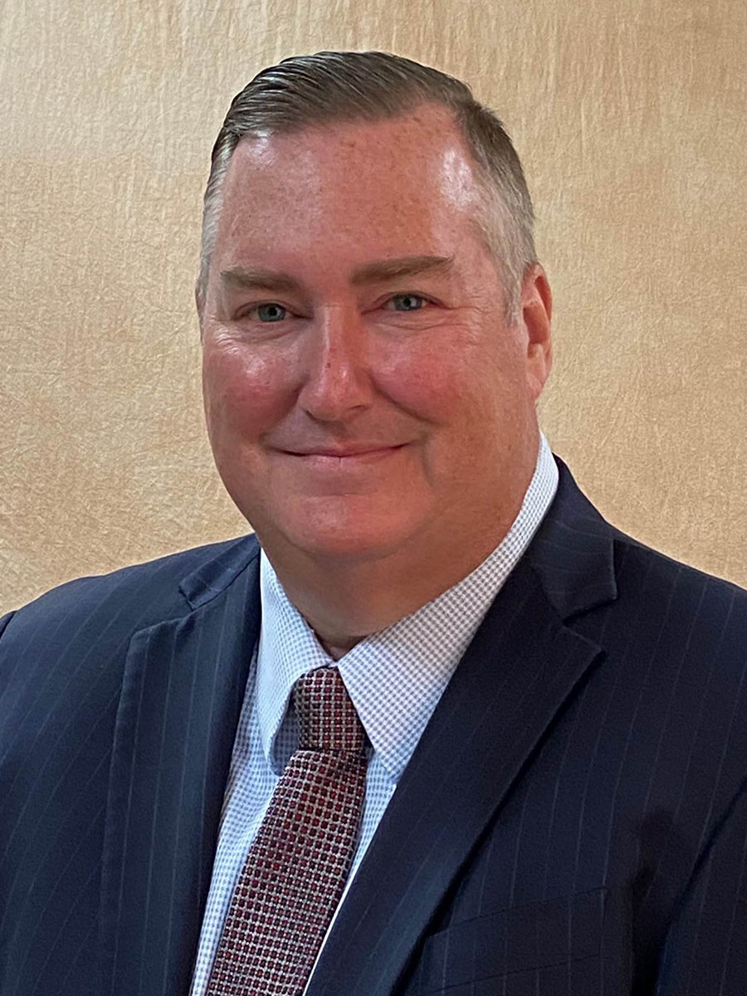
Ameritas…. PDA Opportunities & Bigger, Faster, BETTER!
Lance Larsen, CLU, ChFC, LLIF
Regional Vice President, Ameritas

Slide 2
Anyone Here Know What “PDA” Stands for?

Slide 3
Public Display of Affection???

Slide 4
Premium Deposit Account (PDA)
Do you have a client who…
Has a lump sum of cash looking to put into life insurance?
Looking to buy a “Gift for Life” for grandkids?
Convenience of a one-time payment, and prevent MEC
Consider the Ameritas PDA!

Slide 5
Premium Deposit Account (PDA)
Account attached to insurance policy
Client can “pre-pay”, set up schedule
Money in PDA accrues interest while waiting to be applied to policy
Opportunity to avoid MEC

Slide 6
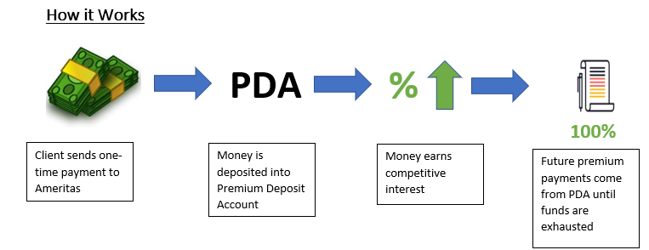
Premium Deposit Account (PDA)

Slide 7
Money on the Sidelines…. “Lazy Money”
$4.56 Trillion in Money Market Accounts 1
Typical MMA APY: 0.08% 2
$154 Billion in CD Accounts 3
Typical 5 Year APY: 0.36% 2
1-As of 3/24/22, ICI.Org
2-As of 3/30/22, Bankrate.com
3-As of 3/30/22, Fool.com

Slide 8
PDA Example #1: Grandpa Joe
Male, 60 years old, decent health
Has $200k in money market or CD, still on the sidelines
Wants to have more protection, living and dying!
Sees this amount as a source of retirement income (someday)

Slide 9
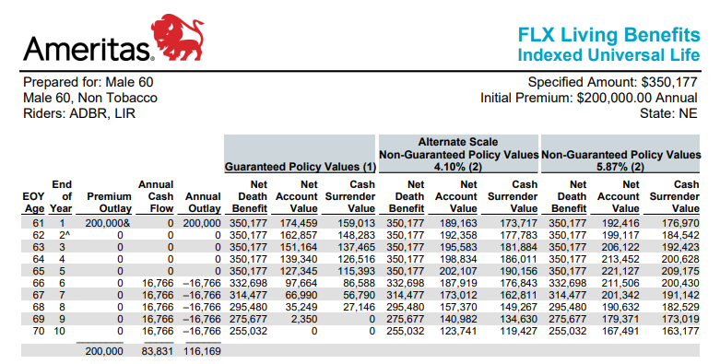
NO PDA Example #1: Grandpa Joe
Male Age 60, Standard NT
Assume Min Non-MEC, Option A
$200,000 Single Pay
Death Benefit: $350,177
Total Premium Paid: $200,000
Retirement Income 65-85: $16,766/yr
Causes a MEC

Slide 10
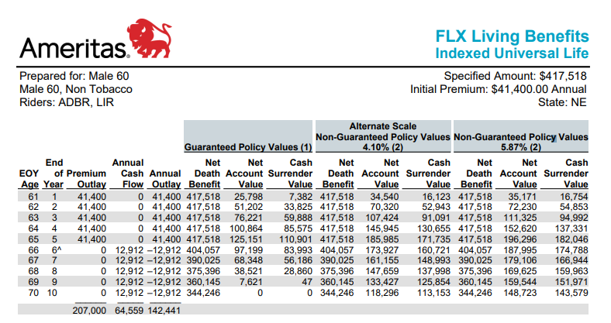
YES PDA Example #1: Grandpa Joe
Male Age 60, Standard NT
Assume Min Non-MEC, Option A
$200,000 into PDA Earning 1.75%
$41,400/year for 5 years
Death Benefit: $417,518
Total Premium Paid: $207,000
Retirement Income 65-85: $12,912/yr
NO MEC!

Slide 11
Benefits in Utilizing PDA for Grandpa Joe
Additional $7000 Interest
Additional Death Benefit & Living Benefits
More Retirement Income vs. Premiums Paid
Payment Plan: Set it and Forget it
Avoids a MEC: Tax Advantages

Slide 12
PDA Example #2: Gift for Grandson Timmy
Grandpa wants to give a gift to Timmy
Has $10k to give him, but how?
Wants Timmy to have same protection, living and dying!

Slide 13
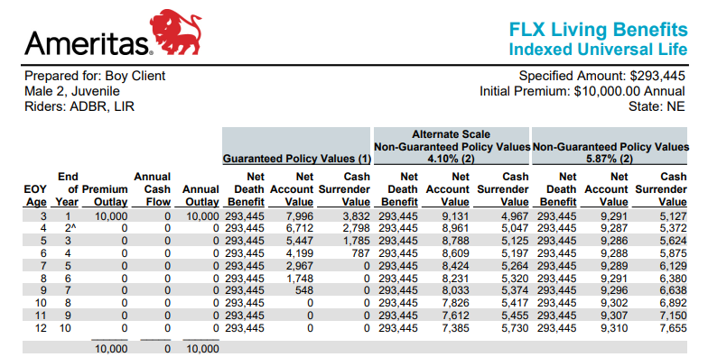
NO PDA Example #1: Grandson Timmy
Male Age 2, Juvenile
Assume Min Non-MEC, Option A
$10,000 Single Pay
Death Benefit: $293,445
Total Premium Paid: $10,000
Retirement Income 65-85: $8,370/yr

Slide 14
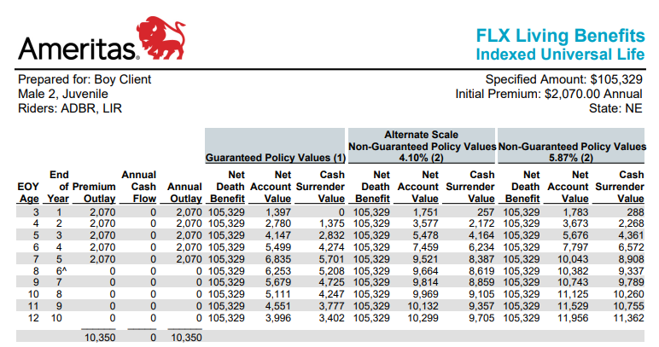
YES PDA Example #1: Grandson Timmy
Male Age 2, Juvenile
Assume Min Non-MEC, Option A
$10,000 into PDA Earning 1.75%
$2,070/year for 5 years
Death Benefit: $105,329
Total Premium Paid: $10,350
Retirement Income 65-85: $21,724/yr

Slide 15
Benefits in Utilizing PDA for Grandson Timmy
Lump Sum can be Easier Sale
Payment Plan: Set it and Forget it
Additional $350 Interest
$267k More in Retirement Income

Slide 16
Premium Deposit Account (PDA)
Do you have a client who…
Has a lump sum of cash looking to put into life insurance?
Looking to buy a “Gift for Life” for grandkids?
Convenience of a one-time payment, and prevent MEC
Consider the Ameritas PDA!

Slide 17
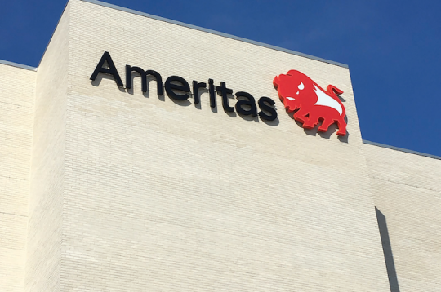
Why Ameritas? It’s a Great Mutual Company!
Here today, Here Tomorrow (19)….
Over $40B Total Assets Under Management
$3B Revenues in 2022
Over $100B of Life Insurance in Force
Over 4.5M Customers
“A+” Standard & Poor’s (Strong)
“A” AM Best (Excellent)
(19) Financial Strength -Ameritas.com, November 2021
Notes:
As you can see on the slide, we have the financial strength to take care of your customers today and more importantly tomorrow. We would love you to give us an opportunity to earn your business!

Slide 18
Why Ameritas? The Products!
FLX Term offers protection with 18 exceptional living benefits. -Convertible to FLX IUL by end of term or age 65
FLX IUL designed for accumulation and income, also with the same 18 exceptional living benefits.
Strong cap with S&P 500 9.25%
Exclusive BNP MMA5 index with no cap and 185% participation rate
Unique way of paying living benefits using the Lien Approach
Income for LIFE

Slide 19
iGo & Magnum: Helping You Deliver Policies Faster
Built with goal to complete the UW process with one interaction
Instant approval on most Non-Med apps

Slide 20
Ameritas…. PDA Opportunities & Bigger, Faster, BETTER!
Lance Larsen, CLU, ChFC, LLIF
Regional Vice President, Ameritas

