Slide 1
Protective Life:
Protective Life and Levinson and Associates
Chris Salamon,
Regional Vice President
April 8,, 2022

Slide 2
Agenda
My Why
Who Is Protective Life
  Strength, Stability and Protection
  New Brand
Protection from Foundation thru Lifetime
  Term
  3 GUL Products
  Riders

Slide 3
Why Life Insurance?

Slide 4


We Are All Protectors: My Why
Parents didn’t have a mortgage
3 sons graduated without college debt
Purchased first home
Head start on lifetime savings
Only 36% of Gen X’rs have exceeded their parent’s wealth
Millennials are 26% less likely to own their own home
Life Insurance Changes Lives!

Slide 5
Protective Life: Strength, Stability, Protection

Slide 6
Protective at a Glance
Founded in 1907
Only seven CEOs
Acquired in 2015 by Dai-ichi Life
(among the largest global life insurers by total assets)
Home office in Birmingham, Alabama
National footprint
3,000+ Employees*
Offices across the U.S.
Guided by mission and values
58 successful acquisitions
Growth Through Acquisitions
Over $4.8B of investment
Virtuous cycle

Slide 7
We Are Highly Rated
 | Protective Life Insurance Company
 | Financial Strength
Standard & Poor’s | AA-
Moody’s | A1
Fitch | AA- *
A.M. Best | A+
Comdex | 93
* Financial Strength Ratings as of March 31, 2022. Upgraded by Fitch March 7th 2022. Ratings are subject to change at any time, and do not apply to products or their performance. A portion of Protective Life and Annuity Insurance Company’s policy liabilities are guaranteed by Protective Life Insurance Company.
Notes:
We continue to earn high financial strength and performance ratings from major rating agencies. Its comdex score is 91.

Slide 8
The Protective Way
Products Designed to Stand the Test of Life
We make promises carefully and deliver
No surprises, no disappointments
We do the right thing
Notes:
The Protective Way is the thought we put into our business, our decisions, even our product design. Our focus revolves around producers and clients, outcomes and doing what we say we will do. We’re careful about the promises we make—and then deliver on them. We work hard to avoid unwelcome surprises and disappointments for clients. We do the right thing. That commitment informs everything we do every day, large and small.
Of all the things we’re most proud, perhaps our products stand out the most. They reflect who we are and embody our core principles. Now, let’s talk about how Protective Indexed Choice UL can deliver for clients.

Slide 9
We are Protectors:
Guarantees and Performance … as Expected

Slide 10

Foundation of Protection: Custom Choice Term UL
Custom Choice Term UL: Term-like UL, offering 10, 15, 20, 25 and 30 year durations
UL core design, available only in term durations
Top 5 Term Pricing vs Peers
Premium doesn’t increase at the end of Level period.
Can accept a 1035 Exchange
Single-pay, Short-Pay and Stair-Step Premium Scenarios
Convertible for 20 years or to Age 70

Slide 11
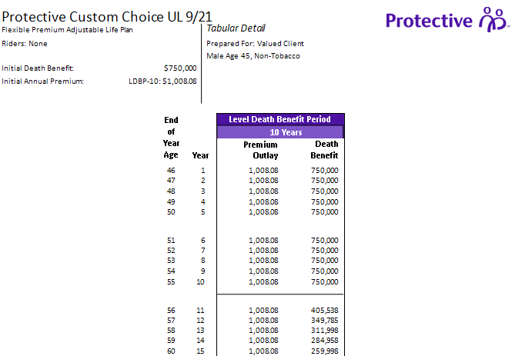
Level Pay Term

Slide 12
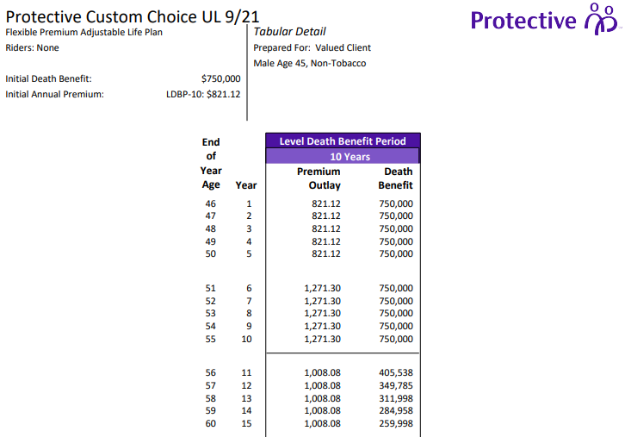
Stepped Premium
An almost 20% Cheaper
Entry Point

Slide 13
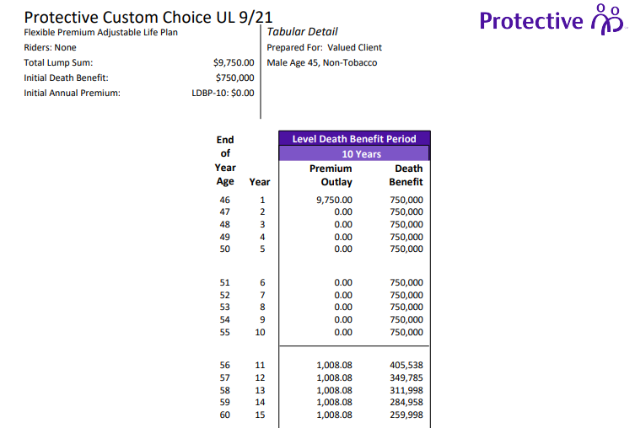
1035 Exchange to “Term”

Slide 14

Foundation of Protection: Classic Choice Term
Consistently Priced and Repriced into Top 3
  91% in the Top 3 slots
  96% in the Top 5 slots
Term Durations of 10,15, 20, 25, 30, 35 and 40 year
New extended issue ages
Convertible to 1 of 3 GUL products at Protective
GREAT Monthly Premiums, sometimes the difference is
pennies
Available in NY

Slide 15
Foundation: Classic Choice Term
$24.68
$290.35
$24.69
$290.36
For a Penny More
Convert to 1 of 3 GUL Products
Protective TeleLife online submission
  Protective does the work for you
  PLUS Accelerated Underwriting
Quick Submission
Competitive Underwriting
Great Service

Slide 16
We are Protectors:
Guaranteed Death Benefit UL

Slide 17
Diminishing GUL Offerings
December 2019: 17 well-priced GUL’s
January 2020, Premium Based Reserving and GUL’s offered drops 23% from 17 to 13
March 2020, Covid-19 – premium limitations, 1035 exchange amount limitations, age limits
April 2020, The 10 Year Treasury drops to 61 Bps
  Many carriers announce price increases
By Summer 2021 number of GUL’s drops to 11
April 2020, Protective Launches its 3rd GUL Product
Protective offers 3 of the 11 GUL Products

Slide 18
Protection from Foundation to Lifetime:
Guaranteed Death Benefit UL (GUL)
- Lifetime Assurance GUL
- Advantage Choice GUL
- Index Choice G – IUL
All Designed to be low-priced, and perform as the agent and the customer expected them to perform when they were originally sold – no surprises.
Notes:
Before we wrap up today’s presentation, I want to go over the transition rules.
<<Slides 14 and 15 can be omitted if we passed the transition period>>

Slide 19
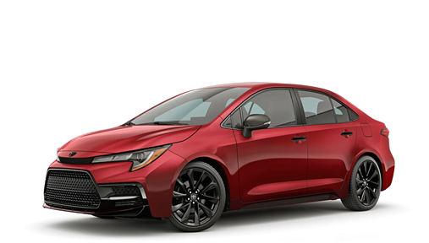
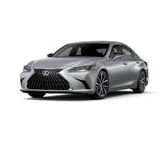
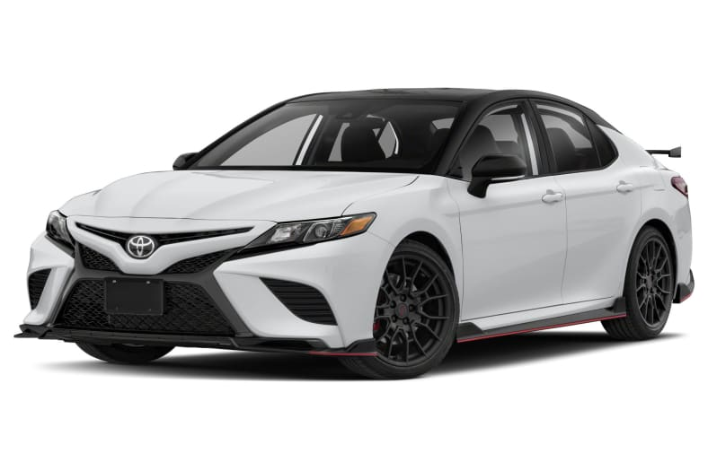
GUL Product Positioning
Lifetime AssuranceSM UL
Level Pay Only
Competitive NLG
  Ages 90 – 121
Limited Flexibility
Advantage ChoiceSM UL
More Customizable
Single Pay, Short Pay, Level Pay
Competitive NLG
Greater Flexibility
Indexed ChoiceSM UL
Most Customizable
Level Pay, Short Pay and Single Pay
Lapse Protection and/or Current Assumption
Greatest Flexibility
Notes:
Protective Lifetime Assurance UL is now one of three UL products in the Protective portfolio.
Prebuilt Home-It’s the most streamlined product available only with level pay case designs, specializing in lapse protection periods all the way to age 121.
Builder with 12 plans to choose from-Protective Advantage Choice UL is more customizable by offering the ability to take lump sums and 1035 Exchanges, along with single pay, short pay or level pay designs.
Custom Home - Finally, Protective Indexed Choice UL is a guaranteed indexed UL product with all of the customization of Advantage Choice UL, but with even greater flexibility based on greater cash value accumulation potential.

Slide 20
Protective Lifetime AssuranceSM UL
Issue Ages
18 – 85
75 for Select Preferred
Lapse Protection
Min: Age 90 / 20 Years
Target = Annualized Level Premium
No Rolling Target
Notes:
Protective Lifetime Assurance UL is a guaranteed universal life product available up to age 85. Lapse protection can be designed for no less than a period to age 90 or 20-years, whichever is greater. Although this is the minimum lapse protection period, having lapse protection for at least 30 years enhances the flexibility of premium timing and catching up. It doesn’t have a rolling target, but the target premium will equal the premium calculated on the illustration.

Slide 21
Return of Premium Endorsement
  25% of premiums paid, available on or after the 10th policy anniversary, upon full surrender
  Limited to 50% of lowest death benefit
  Not limited to a 60-day window
All issue ages
Standard Non-Tobacco, Preferred, or Select Preferred
Rated no higher than Table 4 / $5 flat extra
Notes:
Protective Lifetime Assurance UL has a unique Return of Premium Endorsement. It offers 25% of premiums paid to date, including those for riders or substandard premiums, available on or after the 10th policy anniversary, upon full surrender. The ROP will never be more than 50% of the current death benefit at the time the ROP is invoked. Once the policy reaches the end of policy year 10, the ROP is available and never expires. It’s automatically included in the policy with all issue ages, so long as the underwriting class is anything but the tobacco class, and any substandard ratings are no higher than Table 4 or a $5 flat extra premium. There is no minimum lapse protection period required, other than the product minimum of age 90 or 20 years, to make the ROP available so long as the client meets these other eligibility conditions.

Slide 22
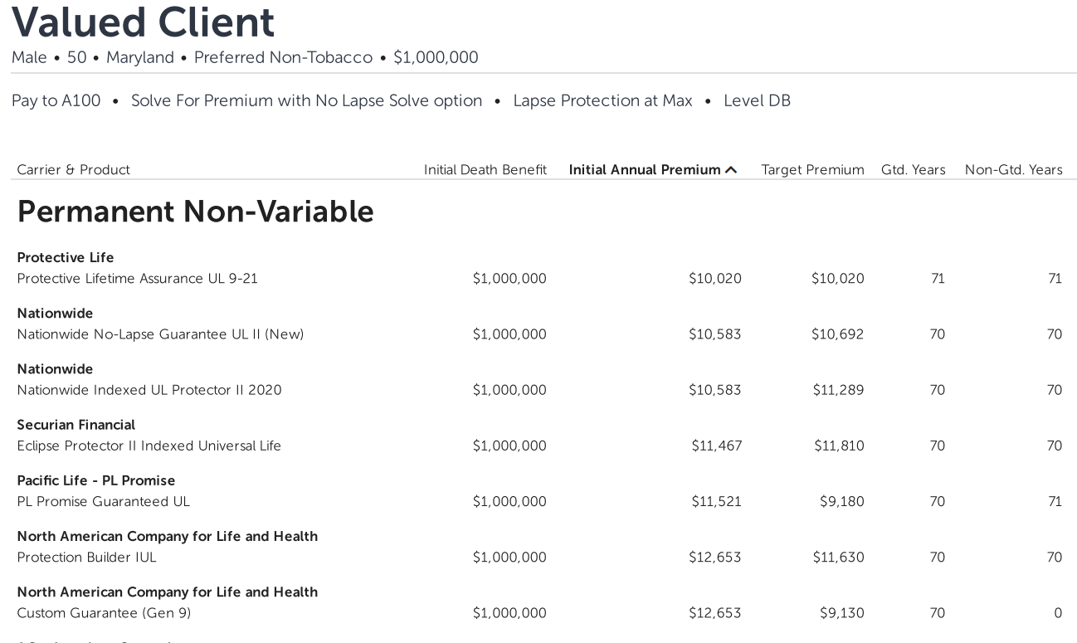

Slide 23
We are Protectors:
Index Choice UL – Guaranteed Death Benefit with Cash

Slide 24
Foundation of Protection: Index Choice G-IUL
Index Choice IUL:
Simple Index UL with Death Benefit Guarantees to age 90 and SUPERIOR Cash Value beyond the Guarantee Period
Low internal cost structure yields superior cash accumulation and better guarantee durations vs. competitors
2 year rolling target
Best suited to compete directly with Life Expectancy GUL products
Accepts Term Conversions

Slide 25
Foundation of Protection: Advantage Choice GUL
Advantage Choice UL: GUL with cash accumulation
Great Guarantee and Great Cash Accumulation that can yield ROP
Great for Lifetime pay, 1035 Exchanges and Short pays
2 Year Rolling Target
Accepts term conversions

Slide 26
We are Protectors:
Extend Care Rider – Chronic Illness

Slide 27



Client Risk
The Use of Long-Term Care¹
15 million: The number of Americans expected to have a high long-term care need by 2050.
52.3%: The expected percentage of people turning 65 who will have a long-term care need during their lifetimes.
35%: Projected increase in number of people with Alzheimer's dementia between 2017 and 2030.
2 years: Average number of years that individuals age 65 and older will have a high long-term care need during their lifetimes.
1. Benz, Christine. “75 Must-Know Statistics About Long-Term Care.” Morningstar, August 31, 2017.
Notes:
Clients may face an imposing amount of risk as they plan for the possibility of using long-term care in their lifetimes. [read from slide.]

Slide 28

My Story: Elder Care

Slide 29
Foundation of Protection: Extend Care, Chronic Illness Rider
Extend Care: Indemnity Chronic Illness Rider
$11,700 Monthly Benefit up to 5% of Death Benefit
Accelerates the Policy Death Benefit Dollar for Dollar
90 Day Elimination Period
Waiver of Premium
No Receipts or Proof of Care, only Certification by their Doctor
Can Receive up to Table 4
Maximum Benefit can be achieved with a low DB of $234,000

Slide 30

Questions

