Slide 1
FOR PROPRIETARY USE: SILAC INSURANCE COMPANY®

Slide 2
HIGHLIGHTS
Benefit-focused FIA
7-, 10- & 14-year versions
Benefit bonus & non-benefit bonus versions
All one-year crediting strategies
S&P 500, Barclays Atlas 5 & CS RavenPack AI
Tremendous benefit growth
5 enhanced benefits
No fees!!!

Slide 3
VEGA BONUS – BENEFIT VALUE ACCUMULATION
Vega Bonus 7
Vega Bonus 10
Vega Bonus 14
Benefit Bonus | 0-80: 20% 81-90: 7% | 0-80: 25% 81-85: 7% | 0-80: 25%
Benefit Multiplier – Deferral | 150% | 175% | 200%
Benefit Multiplier – Payout | 150% | 175% | 200%
Benefit Rate = AV Interest Credit x Benefit Multiplier
If AV had 4% interest credit, Benefit Rate on Vega Bonus 14 = 4% x 200% = 8%

Slide 4
VEGA – BENEFIT VALUE ACCUMULATION
Vega 7
Vega 10
Vega 14
Benefit Bonus | n/a | n/a | n/a
Benefit Multiplier – Deferral | 250% | 275% | 300%
Benefit Multiplier – Payout | 150% | 175% | 200%
Benefit Rate = AV Interest Credit x Benefit Multiplier
If AV had 4% interest credit, Benefit Rate on Vega 14 = 4% x 300% = 12%

Slide 5
HOW CAN THE BENEFIT VALUE BE ACCESSED?
Increasing Lifetime Withdrawals
Level Lifetime Withdrawals
Wellness Withdrawals
Accelerated Withdrawals – 1st of its kind!!!
Enhanced Death Benefit

Slide 6
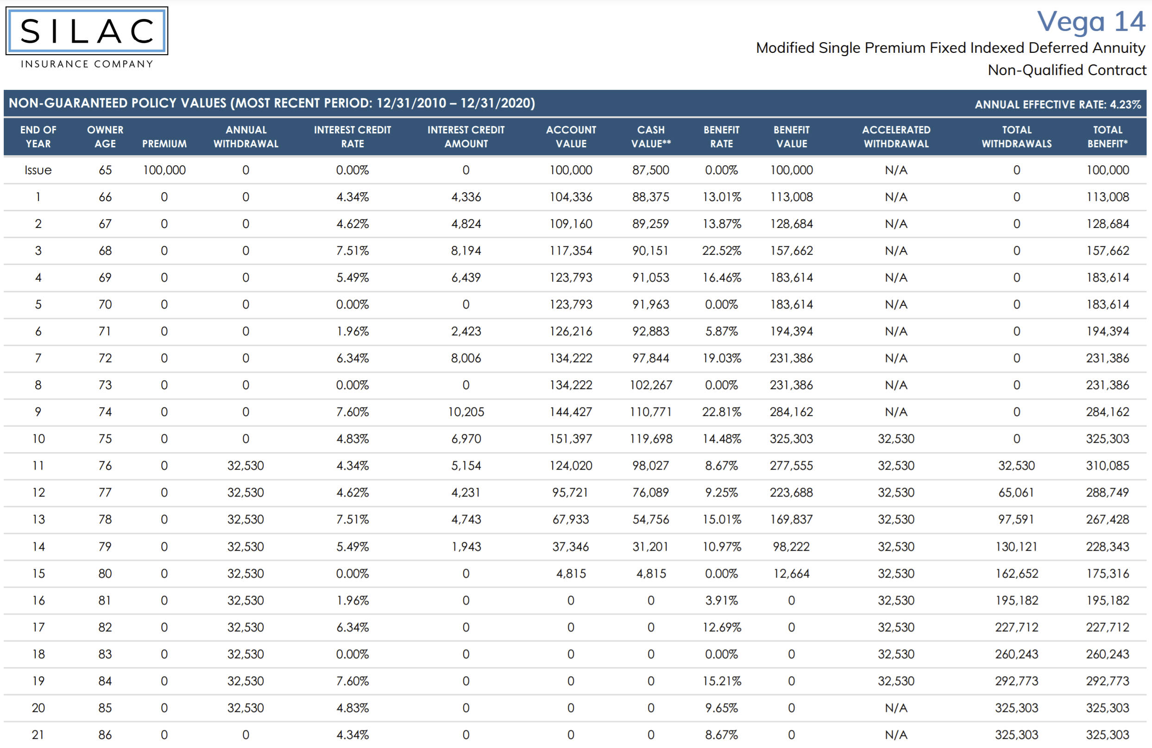
4.34%
300%
13.01%
0.00%
300%
0.00%
7.60%
300%
22.81%
325,303
32,530
AV & BV Depleted
325,303

Slide 7
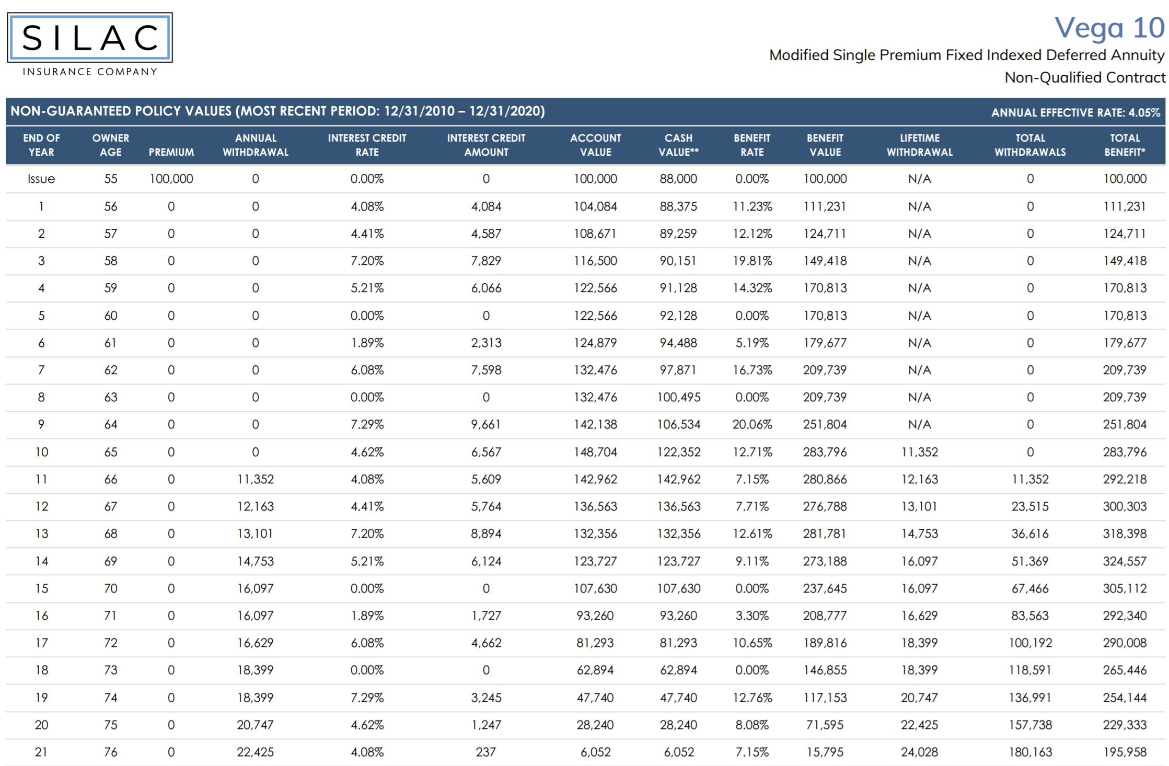
283,796
11,352
4.08%
175%
7.15%
280,866
12,163
Age 90:
62,817
0
0
732,619

Slide 8
2 Year MYGA
Secure Savings and Elite
Over $5 trillion in low yielding accounts – CD’s, Money Market, earning 20 – 50bps.
Provide client with options to earn 1.75% or 2.15%
Don’t tie up funds for a long period of time.
In 2 years, client and agent can decide on new policy/investment.

Slide 9
Annuity Policy Review

Slide 10
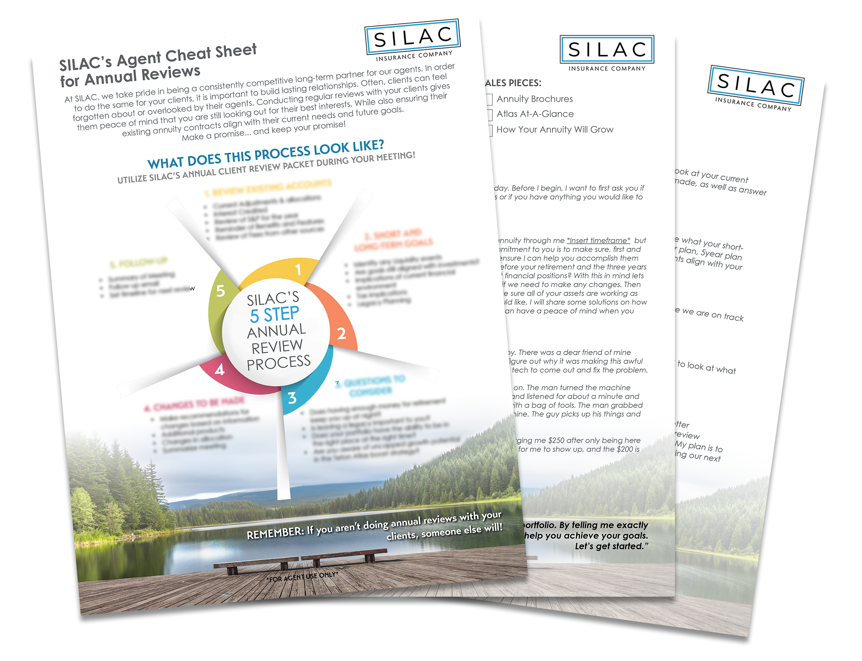
SILAC ANNUAL REVIEW PACK & AGENT CHEAT SHEET
To help you decide WHEN and HOW to perform your annual reviews.

Slide 11
A GALAXY OF RETIREMENT OPPORTUNITIES.
THANK YOU!

